Slide 1
ICI– A Reliable Partner of Network Security
Frictionless Security At The Pace of Innovation
Radware for ISP
Advanced DDoS protection across any infrastructure implementation for service providers.
Secure your data center, private cloud, public cloud and 5G infrastructure using a single vendor solution that is agnostic to the environment and was designed to help service providers protect large-scale networks.
Radware for Enterprise and Banking
A global leader of cyber security and application delivery solutions for physical, cloud, and software defined data centers.
Its award-winning solutions portfolio secures the digital experience by providing infrastructure, application, and corporate IT protection, and availability services to enterprises globally.
Radware’s solutions empower enterprise and carrier customers worldwide to adapt to market challenges quickly, maintain business continuity, and achieve maximum productivity while keeping costs down.

Slide 2
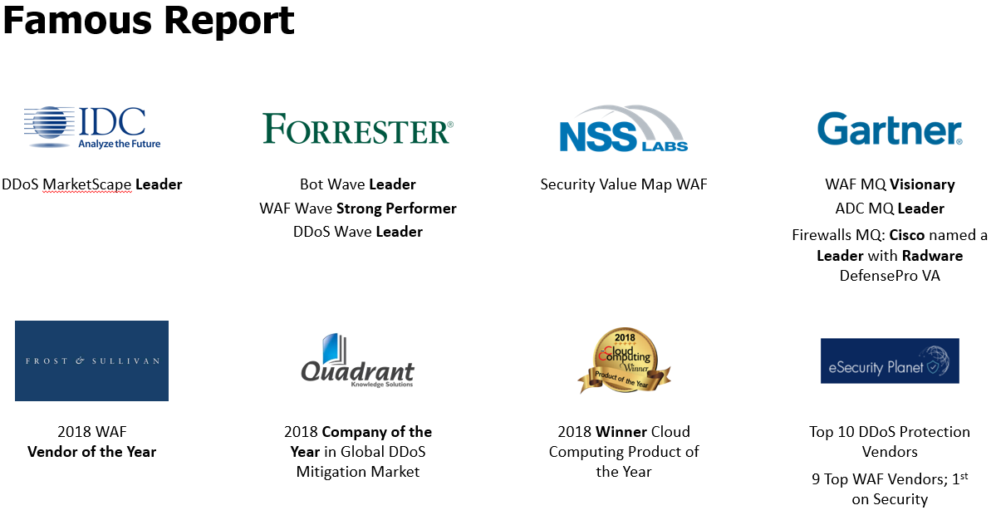
ICI – A Reliable Partner of Network Security
Work, not sell
Treasure time
Engineer to service
Understand reality
See to details
Be responsible
Field first
Trade smoothly
ICSC’s Advantages
Independency
Fast Response
Abundant Stock
Rich Experience
Deep Resources
Strong Engineering
Field Intelligence
Flexible Delivery
No Interest Conflict
Lower Total Cost
Mr. Sim Sopheap, General Manager, ICI
sopheap@ici-cn.com | facebook.com/sopheap.ici | Skype: cambo_sky | Cell: +855 10 815573| Phnom Penh, Cambodia| Cisco Certified Internetwork Expert(CCIE) Security/Router&Switch/Service Provider

Slide 3
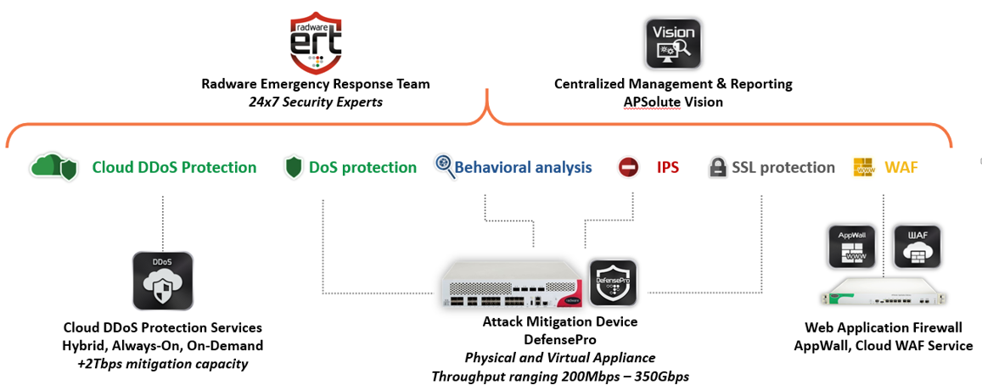
ICI – A Reliable Partner of Network Security
Radware’s Security Solution Elements
The Radware ERT Provides
Fastest DDoS Attack Mitigation
Fully Managed Service
Security Update Service
Technical Account Management
Preemptive Threat Intelligence

Slide 4
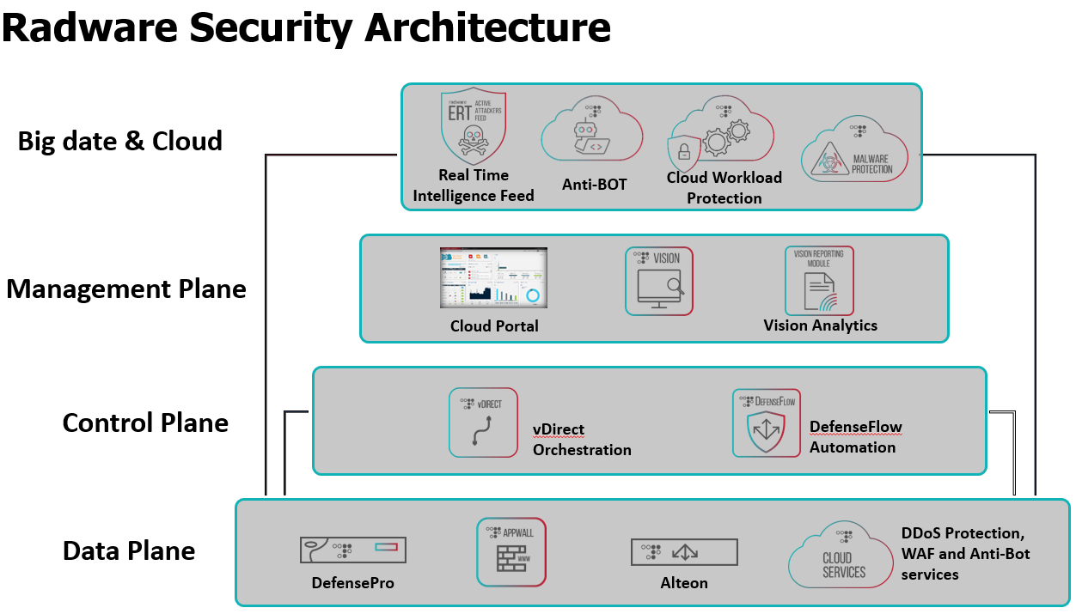
ICI – A Reliable Partner of Network Security
ICI’s Radware Experts:
Provide security Solutions
Support 24/7 for DDoS attack
Optimal DDoS protection & mitigation service to meet Client’s needs
Mr. Sim Sopheap, General Manager, ICI
sopheap@ici-cn.com | facebook.com/sopheap.ici | Skype: cambo_sky | Cell: +855 10 815573| Phnom Penh, Cambodia| Cisco Certified Internetwork Expert(CCIE) Security/Router&Switch/Service Provider
Scan to contact

